Slide 1
PROJECT VIOLET

Slide 2
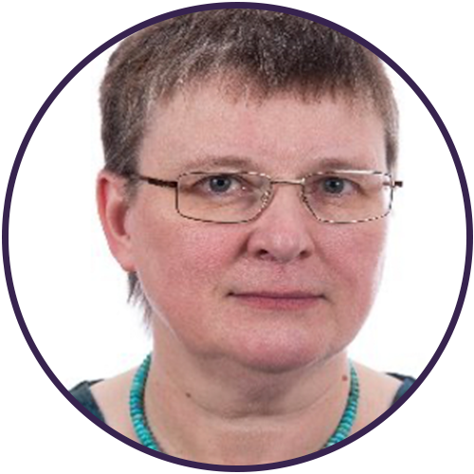
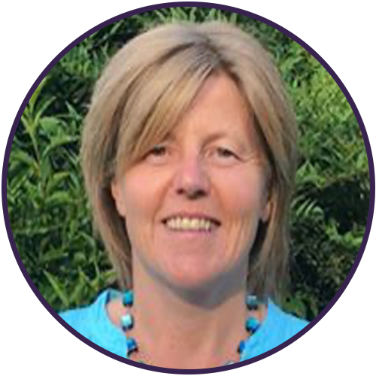
Rev Jane Day Centenary Development Enabler, Baptists Together
Project Violet Co-leaders
Dr Helen Cameron
Research Fellow
Regent’s Park College, Oxford

Slide 3
Project Violet
Reiterate the aims of Project Violet.
Explain where we are at this stage.
Explain what’s coming next.
Share a resource for local churches and Associations to engage with to prepare them to receive the findings.

Slide 4
What is Project Violet?
Project Violet aims to investigate women’s experiences in ministry whilst developing women ministers. The project will help us to understand more fully the theological, missional, and structural obstacles women ministers face in the Baptist community in Great Britain and identify ways forward.

Slide 5
PHASE 1 Stakeholder Engagement 44 Meetings

Slide 6
PHASE 2 49 stories

Slide 7
PHASE 3 Co-researchers
Group One
Group Two
Group Three
Group Four

Slide 8
Theological Reflection Process
Co-researcher reflection group
Theological reflection group
Co-researcher and theological reflection group jointly discern
Discernment at final conference
Easter 2024

Slide 9
Receptive Ecumenism Conference
12 women
5 traditions

Slide 10
How to respond to the findings of Project Violet

Slide 11
An interview with Helen Pankhurst
A resource to accompany the Helen Pankhurst video for local churches and associations
Watch the video: www.baptist.org.uk/helenpankhurst

Slide 12
How to respond to the findings of Project Violet

Slide 13
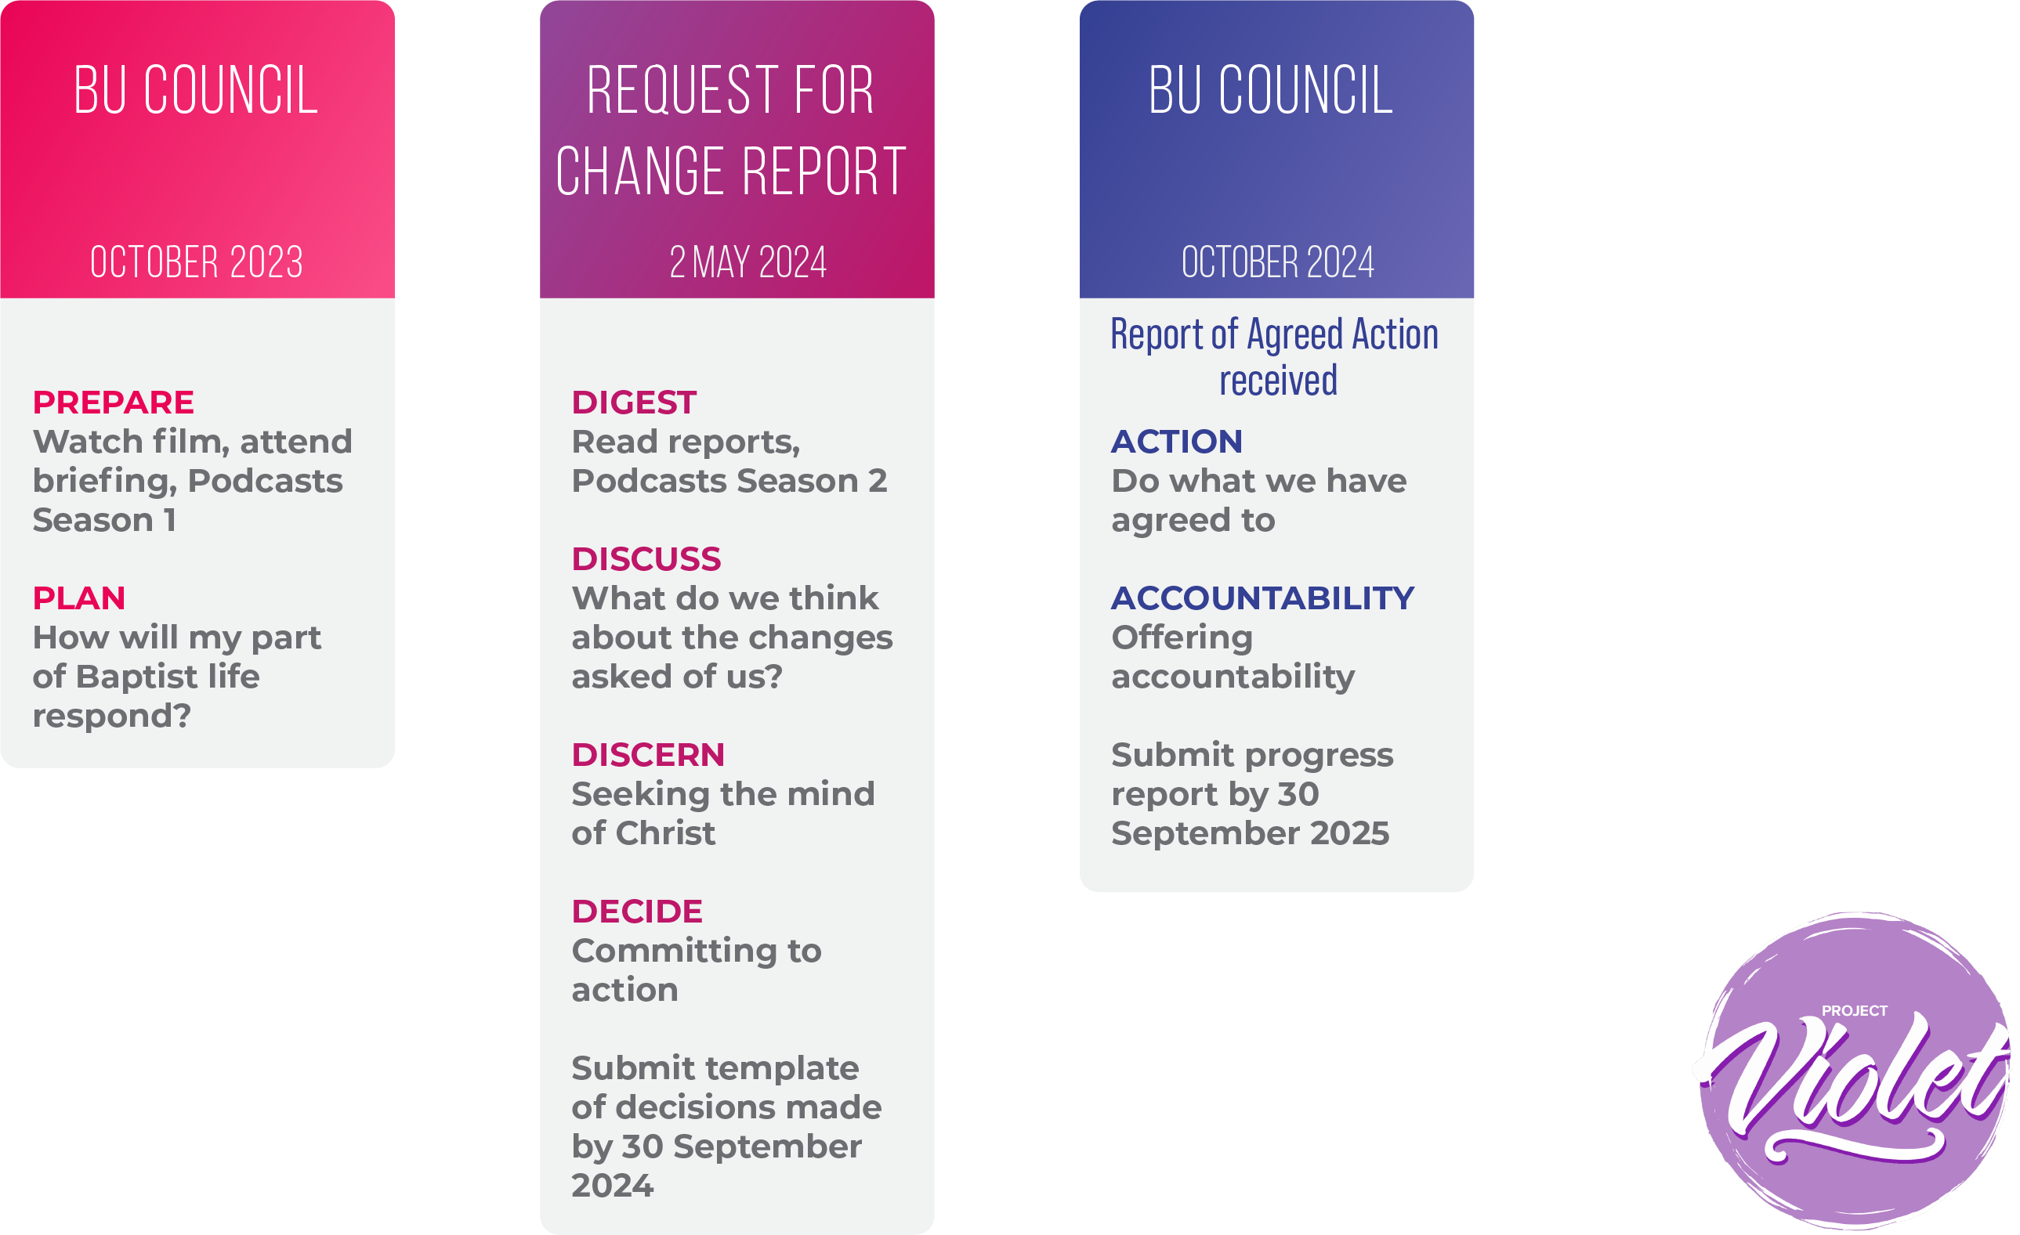
How to respond to the findings of Project Violet

Slide 14
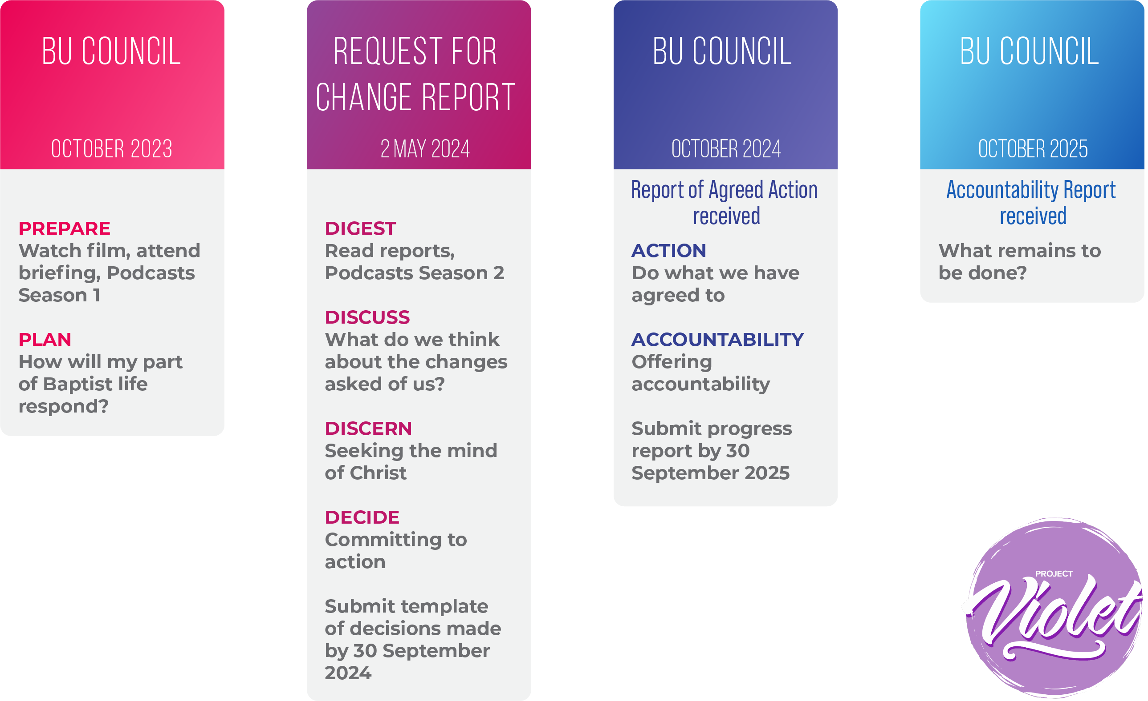
How to respond to the findings of Project Violet

Slide 15
www.projectviolet.org.uk
Email – ProjectViolet@baptist.org.uk
Facebook - ProjectViolet
X - @ProjectViolet1

